Slide 1

“Tua-csc online and mobile voting system”
By: Group 3 -4CS01
Belga, Roque, Manansala & Pansalin

Slide 2
RATIONALE
To develop a new voting system
To help solved problems of CSC election

Slide 3
oBJECTIVES
General Objectives
The study aims to develop an online and mobile voting system that solved problems that the Central Student Council and students have encountered during the previous elections.

Slide 4
Objectives
To allow online voting through the use of smart phones, computers or laptops by accessing the internet; or through SMS (text message) voting
To ease the time allotted for the work of the SCOMEL during the voting day
To encourage greater participation from the students by accessing the appeal of technology
To lessen manpower, materials, and expenses needed for the elections
To automatically count, tally, canvass and transmit votes
To facilitate faster tallying and announcement of election results
To generate of the election results

Slide 5
CURRENT SYSTEM’S FLOWS

Slide 6



3 MAIN PROBLEMS
Time consuming
Tiring
Expensive

Slide 7
Proposed system-system flow

Slide 8
Technical design
CONTEXT DIAGRAM OF TUA-CSC ONLINE AND MOBILE VOTING SYSTEM

Slide 9
Technical design (cont.)
DFD CANDIDATES RECORD IN TUA-CSC ONLINE AND MOBILE VOTING SYSTEM

Slide 10
Technical design (cont.)
DFD OF VOTING PROCESS & GENERATING REPORTS

Slide 11
Technical design (cont.)
DATABASE SCHEMA OF TUA-CSC ONLINE AND MOBILE VOTING SYSTEM

Slide 12
ADVANTAGES OF THE SYSTEM
Minimum skill requirement
Less time consumed
Less expense
User Friendly
Eliminate multiple voting
Organized records
Increase voters turnout

Slide 13
Results and discussion
Due to some problems in the manual election researchers decided to developed an online and mobile voting system.
Students can vote online by accessing the internet through their smart phones or computers.
Students can also vote through SMS (text messaging) by simply texting the keywords made.
The system was able to count and tally the votes automatically.
In online voting system:
“ABSTAIN” button.
Number of students who cast their votes per Colleges or Department
In mobile voting system:
Receiving of vote
Sending of notification

Slide 14
Results and discussion (CONT.)
Limitations:
Only the authorized staff or admin can view the counting and tallying of votes
Only students enrolled in Trinity University of Asia of the said school year can cast their votes
Students cannot cast a vote on both online and mobile, they only must choose one device because the system has its “filter feature”
Result of survey conducted:
98% said they have mobile phones and 95% said they have computers
With regards to our proposed TUA-CSC Online and Mobile Voting System, 90% of the Trinitians are in favour of it.

Slide 15
CONCLUSION
CURRENT VOTING SYSTEM | PROPOSED VOTING SYSTEM
Done through a series of steps | Done through online voting or mobile voting
Ballots, Ballot papers, Stamp pads or indelible ink | Tallying and casting of votes done automatically
Tallying and counting of votes done by hand | Vote records are kept electronically and well organize
Manually keeping of vote records | A simple, easy, and modern way of voting

Slide 16
Recommendation
Researcher’s recommendations in using the TUA-CSC Online & Mobile voting system:
For both system (Online & Mobile)
Conduct a mock election
Uninterrupted Power Supply (UPS)
Mobile Voting
Mobile number include in student form
Inform the admin about the new mobile number
Additional Keywords for mobile voting
Use of GSM modem
Sim card subscribed to a Unlimited text to all network

Slide 17
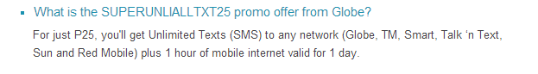
Recommendation (Cont.)
Mobile Voting (continuation)
For globe prepaid sim:
To register: Text SUPERUNLIALLTXT25 and send to 8888
For smart prepaid sim:
ALL-IN 25
Unlimited text to ALL NETWORKS
Valid for 1 day only (P25/day)
For smart prepaid only
To register: Text ALLIN25 and send to 2477

Slide 18
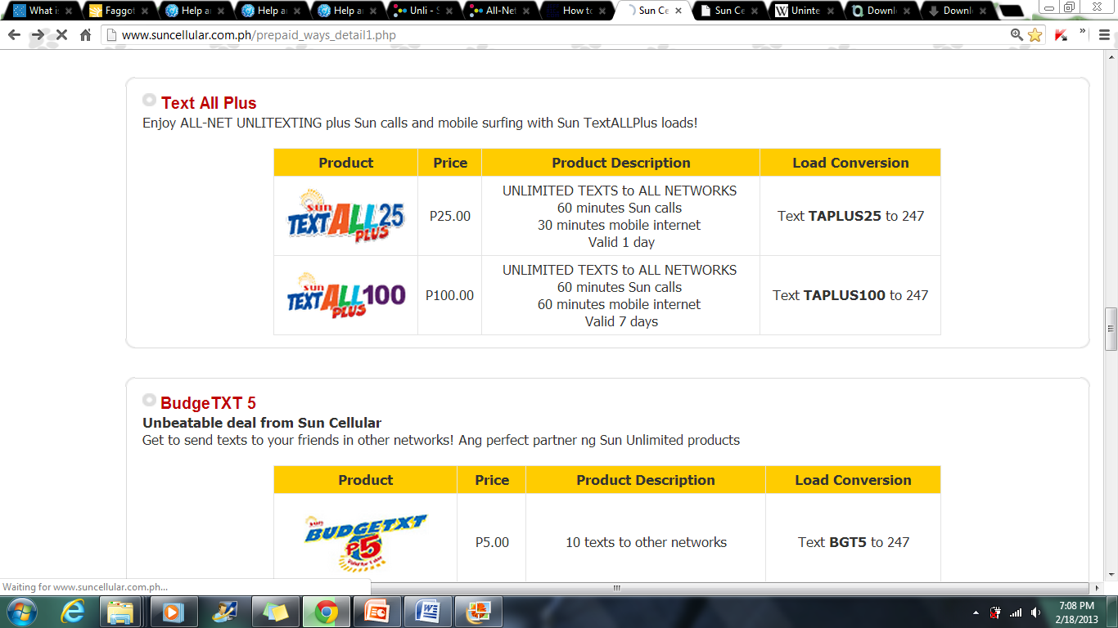
Recommendation (Cont.)
Mobile Voting (continuation)
For sun cellular prepaid sim:
All the said promos allows to send text messages to all networks depending on the sim card that the broadband is using. It is valid in 1 day only, since the CSC election is done in 1 day only, every school year.

Slide 19

GOD BLESS,
THE END.

